Slide 1

DATA ANALYTICS ESSENTIALS · PROJECT REVIEW 1 & 2
Weather Data Analysis System
Daily weather across 10 cities · 2000–2024
Presented by
P. Raghuram
P. Abhi Varun Reddy
M. Shiva Murali Krishna

Slide 2

PROBLEM & OBJECTIVES
Problem statement
Weather affects nearly every aspect of daily life and economic activity: agriculture, transportation, energy demand, disaster preparedness and public health all depend on understanding weather patterns. Raw weather data (temperature, rainfall, humidity, wind speed and more) is collected continuously by meteorological stations, but on its own it is just numbers. The value comes from analyzing it to uncover trends, seasonal patterns and anomalies that can inform decisions. Without systematic analysis, valuable signals such as a gradual warming trend, more extreme rainfall events or predictable seasonal cycles remain hidden in the raw records.

Slide 3
PROBLEM & OBJECTIVES
Objectives of the project
Analyze historical weather data to identify long-term trends (e.g., is temperature rising or falling over time?).
1
Identify seasonal and cyclical patterns in temperature, rainfall and other weather variables.
2
Detect anomalies and extreme weather events within the historical record.
3
Visualize patterns and relationships between weather variables in an interpretable way.
4
Build a simple predictive model, e.g. forecasting temperature or classifying rainy vs. dry days, using the cleaned dataset.
5

Slide 4
DATASET
Dataset selection & understanding
1
Time-series structure
2
Multiple correlated variables
Supports trend and seasonality analysis rather than just static snapshots.
Min, max and mean temperature, rainfall, wind and more enable analysis of relationships between variables.
3
Statistically meaningful size
4
Public and well-documented
Large enough to be meaningful, yet still manageable as a single CSV file for cleaning, exploration and modeling.
Publicly available, so the data provenance and collection methodology are transparent.

Slide 5
DATASET
Where the data comes from
1
2
3
Source
Coverage
Origin
The dataset is sourced through Kaggle.
Historical weather data of India from the year 2000 to 2024.
The original Kaggle dataset was sourced using the OpenMeteo API, a free and reliable weather data API that provides historical climate data for global locations.

Slide 6
DATASET
Features of the dataset
Feature | Description | Significance
Date | Date of the observation | Enables time-series analysis and trend extraction
Max Temperature | Highest temperature recorded during the day (°C) | Key indicator of daytime heat; used to detect heat waves and warming trends
Min Temperature | Lowest temperature of the day, typically overnight (°C) | Indicates night-time cooling; detects cold spells and day/night range
Mean Temperature | Average temperature for the day (°C) | Smooths daily extremes; most common variable for long-term trend analysis
Precipitation | Total rainfall recorded for the day (mm) | Core variable for seasonal (wet/dry, monsoon) analysis and flood-risk indicators
Wind direction | Dominant wind direction of the day | Indicates seasonal wind patterns and cyclones
Max Wind speed | Highest wind speed of the day (km/h or m/s) | Relevant to storm intensity and extreme weather detection
Sunshine duration | Total hours of sunshine during the day | Indicates cloud cover; useful for solar energy potential and temperature/humidity correlation

Slide 7
DATASET
Dataset at a glance
10
24
~91K
8
cities
years (2000–2024)
daily records
core weather variables
Raw variables
Engineered features
Max / min temperature and apparent temperature
Precipitation sum, weather code
Wind speed, gusts and dominant direction
month, year and season
precipitation_log = log(1 + rain)
weather_label (readable weather code)

Slide 8

PREPROCESSING
Data preprocessing and feature engineering

Slide 9
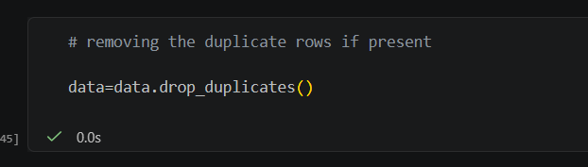
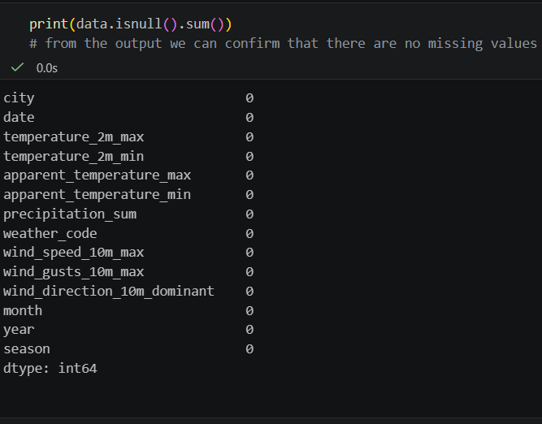
PREPROCESSING
Handling missing values and duplicates
Data is inspected using pd.info() and pd.head()
Missing values are checked using pandas method pd.isnull()
Duplicate values are removed using pandas method pd.dropduplicates()

Slide 10
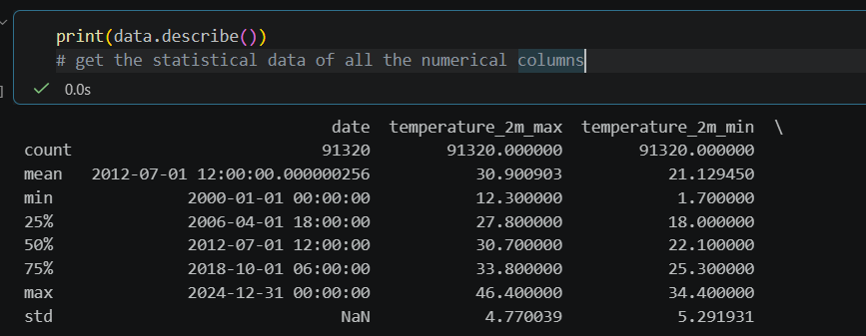
PREPROCESSING
Statistical analysis
Statistical metrics such as mean, median, standard deviation and quartiles are computed using the pandas method pd.describe().

Slide 11
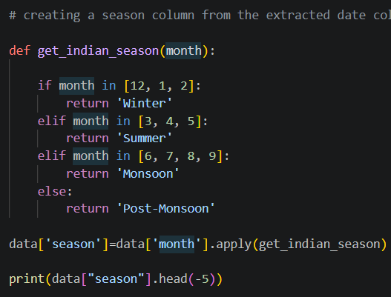

PREPROCESSING
Feature engineering
The existing features of the dataset may be insufficient
Hence new features such as month and season are constructed from existing features such as date
These new features lead to better and deeper analysis

Slide 12
PREPROCESSING
Engineered features
Date parts
Season label
Month and year extracted from the date to study trends and seasonality.
Each record tagged Winter, Summer, Monsoon or Post-Monsoon.
Log precipitation
Weather label
log(1 + rain) reduces the heavy right skew of daily rainfall.
Numeric weather codes decoded into 10 readable conditions.

Slide 13
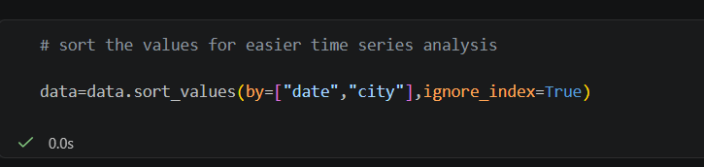
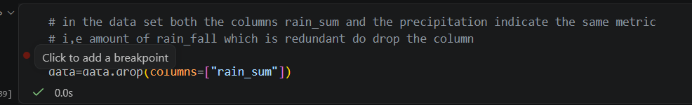
PREPROCESSING
Other preprocessing methods used
The dataset is sorted by the columns date and city
The date, given in string format, is converted into a pandas date object
The columns rain_sum and precipitation_sum indicate the same metric, so rain_sum is dropped

Slide 14
EXPLORATORY ANALYSIS
Approach: from raw data to insights
1
2
3
4
5
Data
Univariate
Groups
Relationships
Time
Load preprocessed daily records
Distributions of temperature, rain, conditions
Compare seasons and cities
Scatter plots and correlations
Yearly trends and monthly seasonality
All charts were built in Python with pandas and matplotlib.

Slide 15
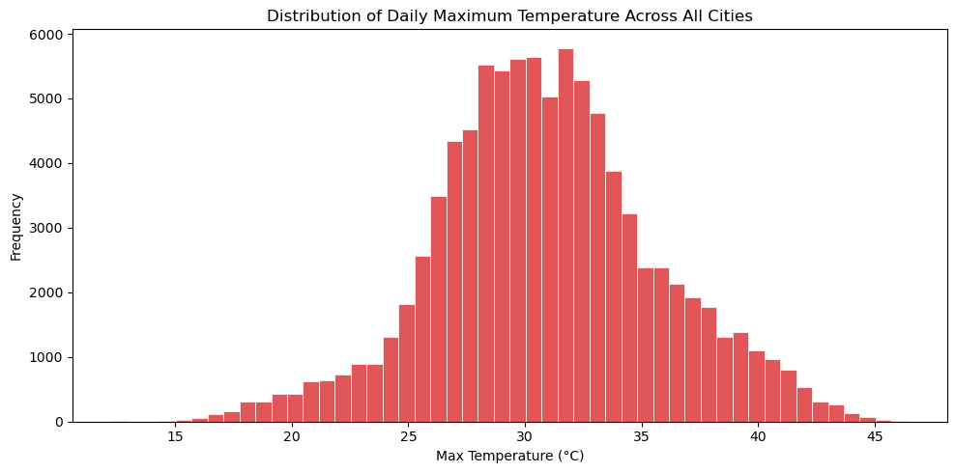
EXPLORATORY ANALYSIS
Daily maximum temperature
Key insight
Roughly bell-shaped, centered near 30–32°C
Range runs from about 12°C to 46°C across cities
A mild left tail comes from cooler winter days

Slide 16
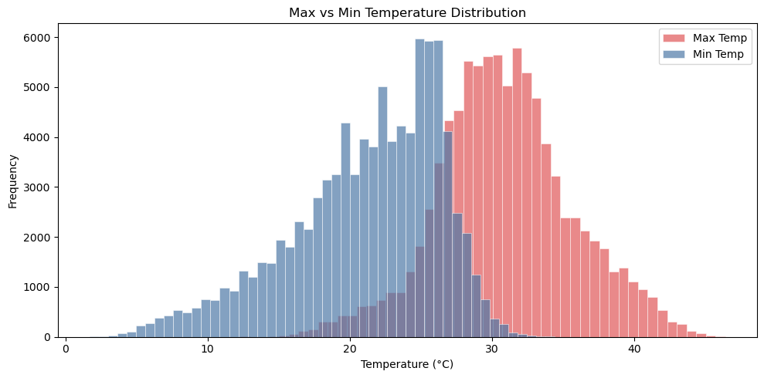
EXPLORATORY ANALYSIS
Max vs min temperature
Key insight
Max temps cluster around 27–35°C
Min temps peak near 25°C but spread much wider
Distributions overlap in the 25–28°C band

Slide 17
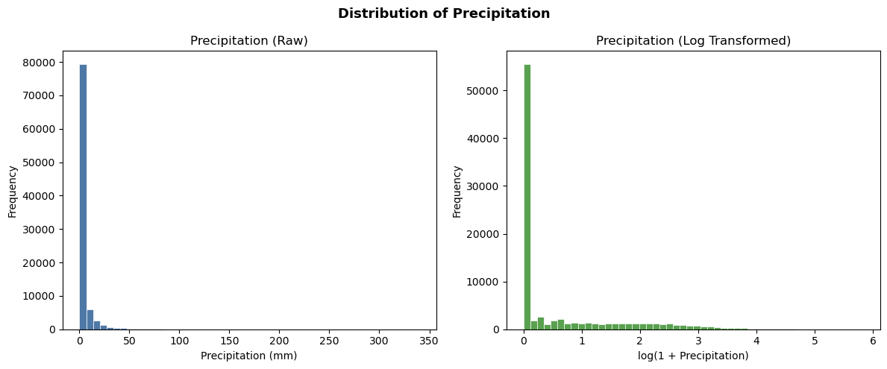
EXPLORATORY ANALYSIS
Precipitation: raw vs log
Key insight
Most days record zero or near-zero rain
Extreme days reach about 340 mm
log(1 + rain) compresses the long tail for modeling

Slide 18
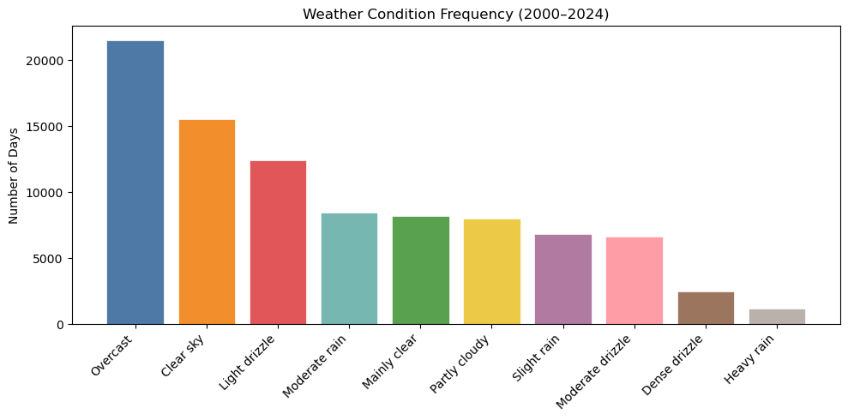
EXPLORATORY ANALYSIS
Weather condition frequency
Key insight
Overcast is the most common condition (~21K days)
Clear sky (~15K) and light drizzle (~12K) follow
Heavy rain is the rarest, at roughly 1K days

Slide 19
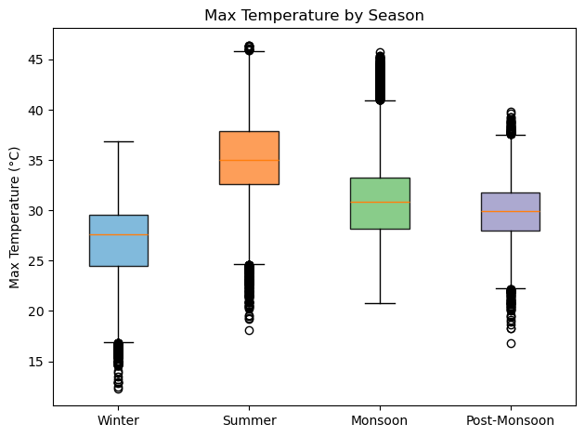
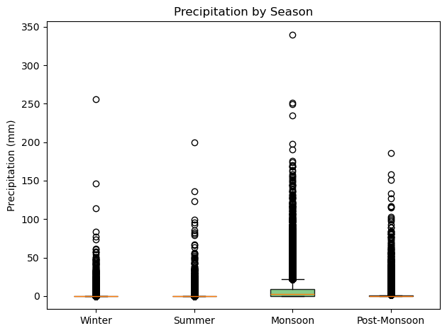
EXPLORATORY ANALYSIS
Seasonal patterns
Summer is the hottest season (median ≈35°C); the Monsoon brings the highest median rain and the heaviest extremes.

Slide 20
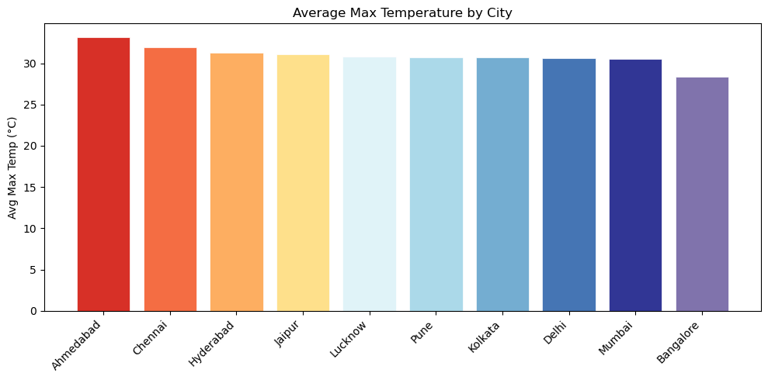
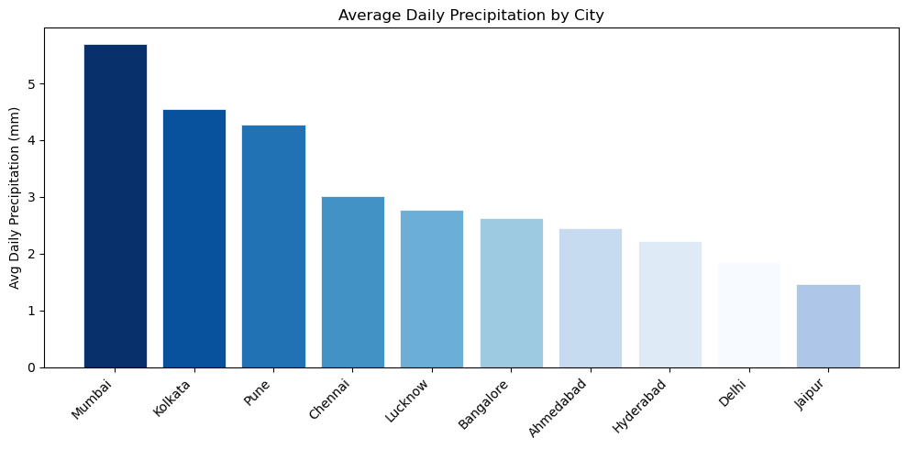
EXPLORATORY ANALYSIS
City comparison: temperature and rainfall
Hottest city (Ahmedabad, ~33°C) and wettest city (Mumbai, ~5.7 mm/day) differ, so heat alone does not predict rain.

Slide 21
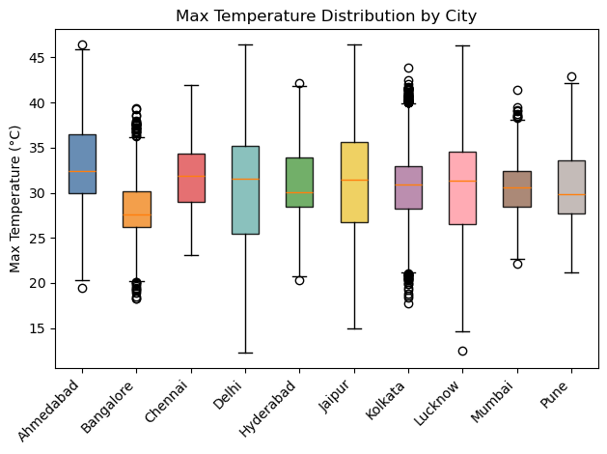
EXPLORATORY ANALYSIS
Temperature spread by city
Key insight
Delhi, Lucknow and Jaipur swing widest (~12–46°C)
Chennai is steadiest, with a high floor near 23°C
Bangalore is coolest, with a median near 27.5°C

Slide 22
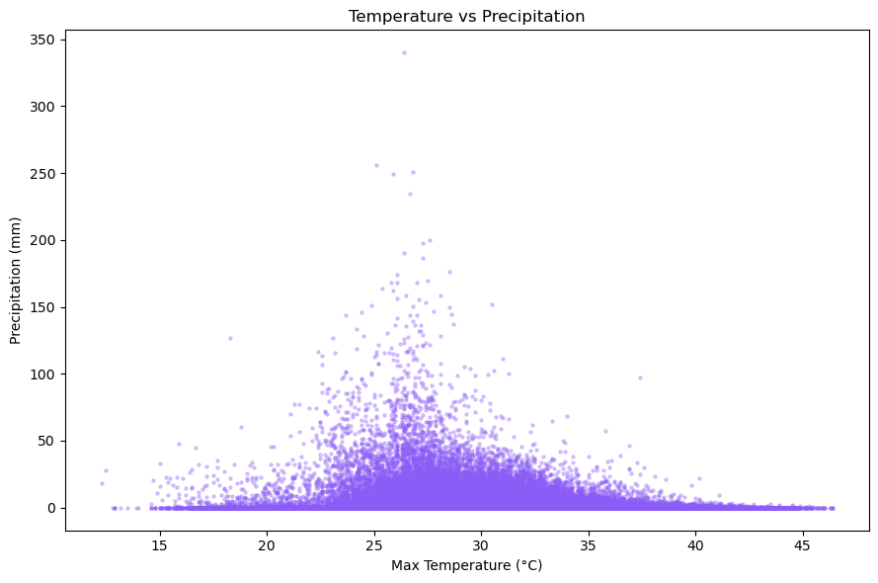
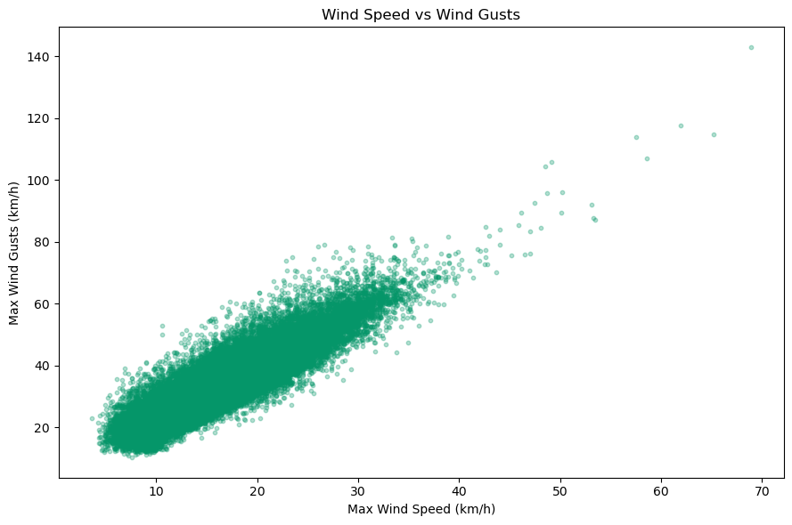
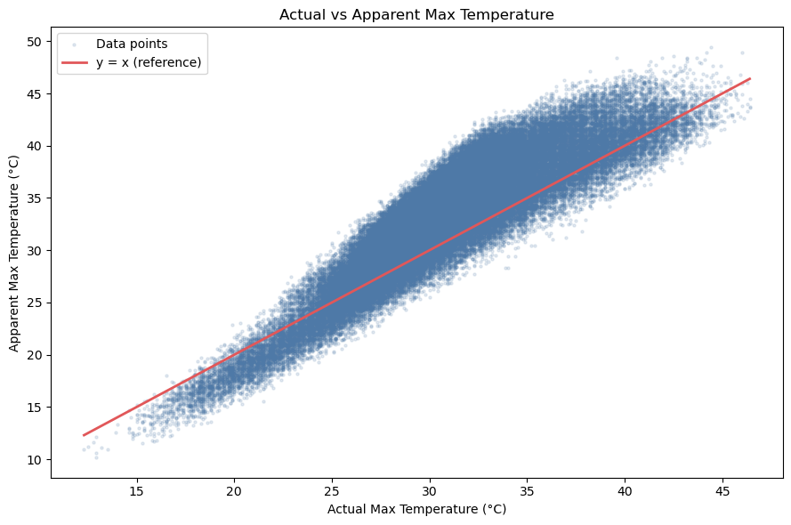
EXPLORATORY ANALYSIS
Relationships between variables
Rain peaks at 24–32°C and nearly vanishes above ~38°C.
Gusts rise almost linearly with wind speed (r ≈ 0.91).
Apparent temperature is higher than actual in the mid range, lower at extreme heat.

Slide 23
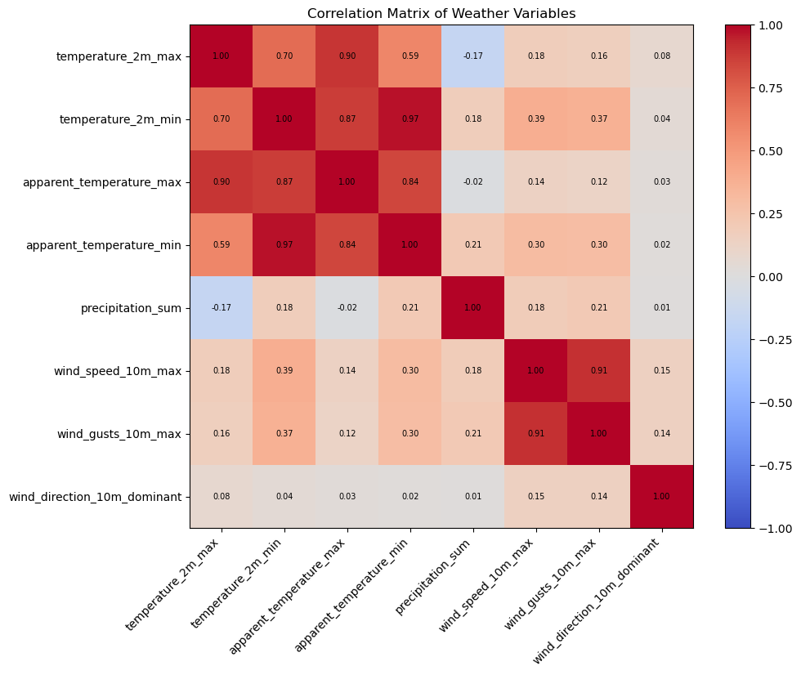
EXPLORATORY ANALYSIS
Correlation matrix
What stands out
Temperature and apparent temperature: r ≈ 0.90 (max), 0.97 (min)
Wind speed and gusts: r ≈ 0.91
Rain vs max temperature: weak negative (−0.17)
Wind direction is nearly uncorrelated with everything
Redundant pairs are candidates to combine or drop in modeling

Slide 24
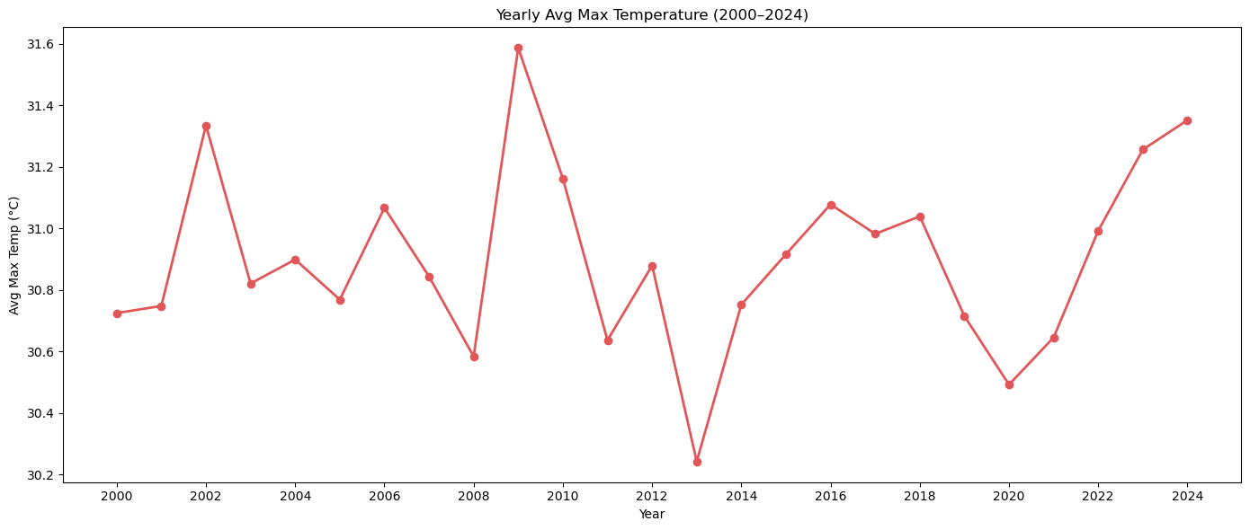
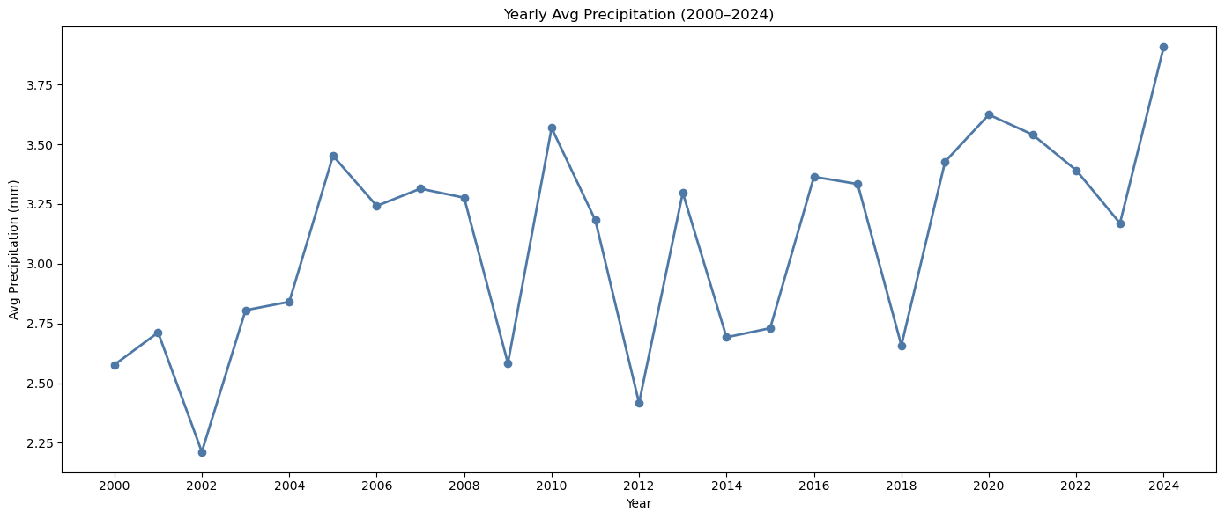
EXPLORATORY ANALYSIS
Yearly trends, 2000–2024
Average max temperature stays within ~30.2–31.6°C, while average rainfall drifts up from ~2.6 mm to ~3.9 mm; both are noisy year to year.

Slide 25
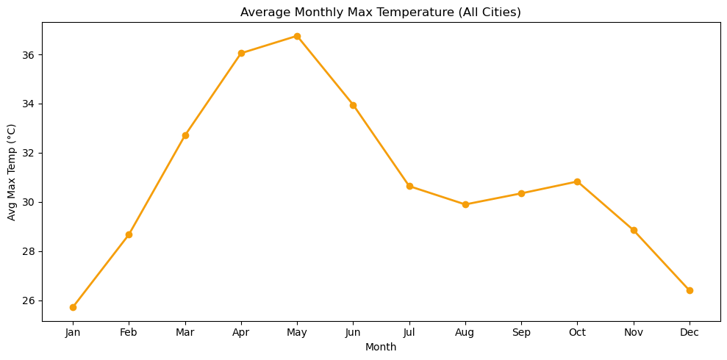
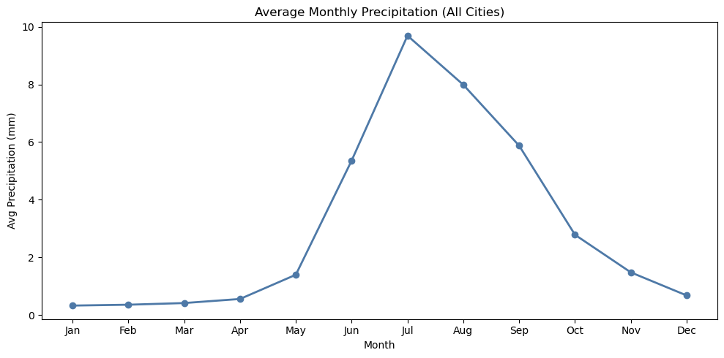
EXPLORATORY ANALYSIS
Monthly seasonality
Temperature peaks in May (~36.7°C) and rain peaks in July (~9.7 mm); the monthly swing (≈11°C) dwarfs year-to-year change (≈1°C).

Slide 26
SUMMARY
Key findings
Summer heat
Monsoon rain
Skewed rainfall
Apr–Jun is hottest, peaking in May near 36.7°C.
Jun–Sep delivers most rain, with a July peak.
Most days are dry, so a log transform helps.
City contrast
Redundant features
Weak yearly trend
Ahmedabad is hottest, Mumbai wettest, Bangalore mildest.
Temperature and wind pairs are highly correlated.
Seasonality outweighs year-to-year change.

Slide 27
SUMMARY
Conclusion and next steps
What we learned
Next steps
Weather here is driven by strong seasonality
Rainfall is highly skewed and monsoon-dominated
Cities differ clearly in heat, rain and variability
1
Predict daily temperature and rain with ML models
2
Cluster cities by climate profile
3
Decompose and forecast the time series

